Slide 1
Topics
Arrays
Object Oriented Programming
Classes and Objects
Encapsulation
Constructors
Static fields and methods
Method calling
Inheritance (IS-A Relationship)

Slide 2
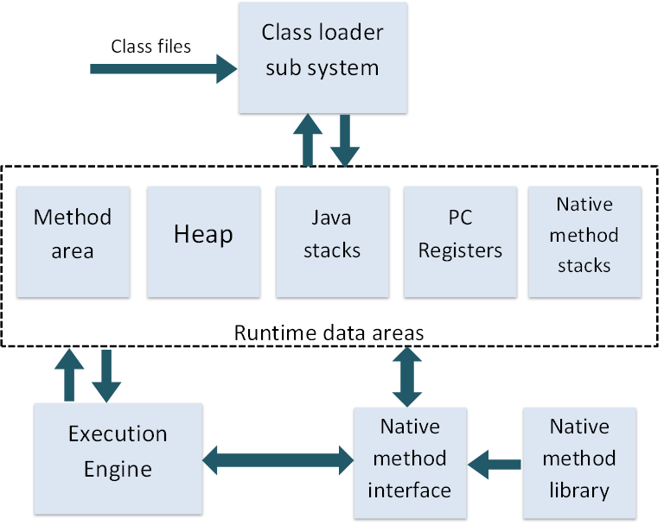

Slide 3
Arrays
An array is simply a sequence of either objects or primitives, all of the same type and packaged together under one identifier name.
A one-dimensional array on the heap
Values
The heap
0
0
0
0
int[] numbers;
0
1
2
3
int [] numbers object
type
Identifier name
Indices
Indexing operator
int numbers[] ;
numbers = new int[4];

Slide 4
Working with Arrays
public class Array {
public static void main(String[] args) {
int[] numbers = new int[3];
numbers[0]=100;
numbers[1]=200;
numbers[2]=300;
int[] newNumbers = {1,2,3};
for (int i=0; i<numbers.length; i++) {
System.out.println(numbers[i]);
}
sumNumbers(numbers);
sumNumbers(new int[]{3,2,1});
numbers = newNumbers;
}
static void sumNumbers(int[] n) {
int sum=0;
for (int i=0; i<n.length; i++) {
sum += n[i];
}
System.out.println(sum);
}
}
length gives the size of the array
Printing each element of an array
Passing array to a method
Assigning array to another array
Passing anonymous array

Slide 5
OOPs Concepts
> Classes
> Objects
> Encapsulation
> Abstraction
> Inheritance
> Polymorphism

Slide 6
Method calling
A method refers to a piece of code referring to behaviors associated either with an object or its class
A code found in a class for responding to a message
The executable code that implements the logic of a particular message for a class
An operation or function that is associated with an object and is allowed to manipulate the object's data

Slide 7
Creating a method
Steps in declaring a method
Set the return type
Provide method name
Declare formal parameters
class Number {
int multiply(int i, int j) {
return i*j;
}
int divide(int i, int j) {
return i/j;
}
double getPi() {
return 3.14159265358979;
}
void printSum(int i, int j) {
System.out.println(i+j);
}
}
method signature
consists of the method name and its parameters
must be unique for each method in a class
return statement
allows the method to return a value to its caller
also means to stop the execution of the current method and return to its caller
implicit return at the end of the method
A method with empty parameters
A method that does not return a value must specify void as its return type

Slide 8
Method calling
How to call a method
  Method name should match
  Number of parameters should match
  Type of parameters should match
Ways of calling a method
  Calling a method through its object name
  Calling a method within the same class
  Calling a static method through its class name

Slide 9
Method calling
public class JavaMain {
public static void main(String[] args) {
// create a Person object
Person you = new Person();
you.talk();
you.jump(3);
System.out.println(you.tellAge());
JavaMain.talkOnly(you);
// create object of main program
JavaMain me = new JavaMain();
me.jumpOnly(you);
}
public static void talkOnly(Person p) {
p.talk();
}
public void jumpOnly(Person p) {
p.jump(2);
}
}
class Person {
void talk() {
System.out.println("blah, blah...");
}
void jump(int times) {
for (int i=0; i<times; i++) {
System.out.println("whoop!");
}
}
String tellAge() {
return "I'm " + getAge();
}
int getAge() {
return 10;
}
}

Slide 10
Method call stack
The Method Call Stack refers to all the methods currently active and being processed by a Java application
invoke print()
invoke compute()
invoke check()
main() begins
print()
compute()
check()
main()
execute print()
execute compute()
execute check()
main() ends

Slide 11
Passing parameters
Passing parameters in Java is always Pass by Value!
When passing a parameter of primitive type:
  A copy of the value of the variable is passed
  The passed variable cannot be changed in the called method as the method only possesses a copy of that variable.
When passing a parameter of reference type:
  A copy of the reference (address) of the object is passed
  The object reference cannot be changed in the called method (i.e., the object cannot be reassigned to another object)
  The object state can be changed in the called method (i.e., attributes can be modified)

Slide 12
Passing object as a parameter
The heap
Stack Memory
Policy Object
pl
state
change
p
main

